Slide 1
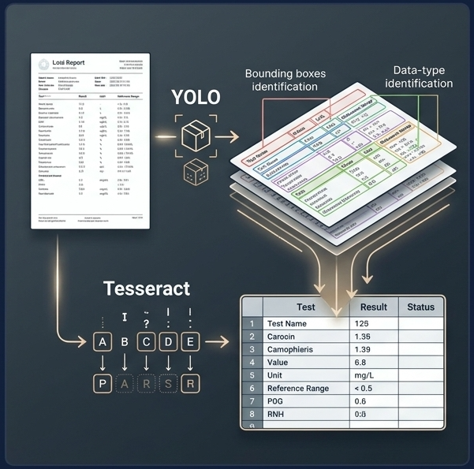
Reading lab reports with YOLO and Tesseract
PROJECT 10 · CUSTOM OCR ON AWS
From a photo, scan or PDF of a lab report to an editable CSV or Excel file, one row per test
Subharshi Das Purkayastha · October 2026
Notes:
This project turns photos, scans and PDFs of printed lab reports into structured spreadsheet rows. A YOLO object detector finds where each field is on the page, and Tesseract OCR reads what it says. The image shows a real test photo from the dataset, with the detector’s boxes: blue for test names, red for values, green for units and purple for reference ranges. Patient details are redacted in every image we publish.

Slide 2




Lab results are trapped in photos and PDFs
THE PROBLEM
In: a report
Find, then read
Out: a table
A phone photo, a scan or a PDF of a printed lab report: tilted, blurred, cropped, colour-cast
YOLO locates each field; Tesseract reads the cleaned crop; rows are rebuilt from geometry
CSV or Excel: test name, value, unit, reference range, confidence and a review flag
Goal: turn every report into rows a lab system can search, chart and audit, and send anything uncertain to a person instead of guessing.
Lab Report OCR · YOLO + Tesseract
2
Notes:
Results printed on paper and shared as photos or PDFs cannot be searched, charted or audited. The project’s job is to turn them into structured data. The approach has two models: an object detector that finds where the fields are, and an OCR engine that reads them. Reading small, clean crops is far more accurate than running OCR on a whole noisy page: whole-page Tesseract found only 74% of the values anywhere in its output. The last design goal matters most for medical data: when the system is unsure, it says so.

Slide 3
What the project covers, and what it does not
SCOPE
In scope
Out of scope
Printed reports in 3 trained designs: thyroid, liver, vitamin
Photos, scans and PDFs, including multi-page PDFs
4 fields per test: name, value, unit, reference range
CSV and Excel output with a review flag per row
Colab + Drive and AWS SageMaker + S3 workflows
Web app, JSON API and a Docker image
Handwritten reports
New lab layouts without 5–10 labelled pages
Patient details: never extracted, always redacted
Clinical interpretation or diagnosis
A live AWS deployment (scripts tested offline)
Lab Report OCR · YOLO + Tesseract
3
Notes:
The scope is defined by the data. The 100 photos show only three printed report designs, so the detector knows those three layouts; a new lab’s format needs a handful of labelled pages before it can be read. Inputs can be photos, scans or PDFs. The output is deliberately narrow: four fields per test, never the patient’s name or IDs. The system extracts data; it does not interpret results. The AWS part is fully scripted and tested offline, but it has not been run against a live AWS account.

Slide 4
Every task in the brief, delivered
THE BRIEF
Brief task | Delivered as
1.1 Colab + Google Drive | Notebooks 01–05 mount Drive and create datasets/, model/, results/
1.2 SageMaker + S3 | Notebook 06 and aws/: S3 sync, notebook instance, training job
2 Data preparation | 100 photos labelled in YOLO format, leakage-safe split
3 Train and validate YOLOv3 | YOLOv3 and YOLO26n trained on GPU, validated, weights in model/
4 Crop → Tesseract → CSV | python Custom_OCR.py --image <photo or PDF>
5 Evaluate and optimise | Ground-truth scoring, preprocessing ablation, error analysis
6 Automation and deployment | Batch CLI, web app + API, Docker, SageMaker endpoint and batch job
7 Documentation | Six notebooks, README, brief checklist and a PDF report
Lab Report OCR · YOLO + Tesseract
4
Notes:
Each numbered task in the project brief maps to a concrete deliverable. The repository’s BRIEF_ALIGNMENT.md file has the full item-by-item check. Three deliberate deviations are worth stating up front. First, YOLOv3 was trained as asked, but a smaller modern model, YOLO26n, ships as the default because it scored better on validation (slide 9). Second, the default preprocessing drops the Gaussian blur because tuning showed it hurts; the brief’s exact recipe is still available as a mode. Third, the AWS scripts have only been run in dry-run mode, without a live account.

Slide 5
100 photos, but only three printed reports
HOW IT WAS BUILT · DATA
100
3
1,760
74/12/14
photos from the course dataset
report designs: thyroid, liver, vitamin
labelled fields, every one checked by eye
train / validation / test photos
The photos are re-shoots of the same three reports under different tilt, blur, crop and colour cast. Near-duplicates are grouped by perceptual hash and kept in one split, so test scores measure robustness to photo conditions, not generalisation to new lab layouts.
Lab Report OCR · YOLO + Tesseract
5
Notes:
The most important finding about the data came before any modelling: the 100 photos are not 100 reports. They are many photos of just three printed reports, a thyroid panel, a liver panel and a vitamin page. That has three consequences. A random split would leak near-identical photos into the test set, so near-duplicates were grouped with a perceptual hash and assigned to one split together, stratified by report type. It also made annotation much cheaper (next slide). And it limits what we can claim: the scores show how well the pipeline copes with new photos of known layouts.

Slide 6

64 boxes drawn by hand became 1,760 labels
HOW IT WAS BUILT · ANNOTATION
STEP 1
STEP 2
STEP 3
Draw once
Match
Warp and check
64 boxes and their text, checked by hand on one master photo per report
SIFT keypoints + RANSAC find each photo’s homography to its master
Boxes warped onto all 100 photos, written as YOLO labels, inspected on QA sheets
test_name · TOTAL THYROXINE (T4)
value · 2.14
unit · µIU/ml
reference_range · 0.3-5.5
Lab Report OCR · YOLO + Tesseract
6
Notes:
Because every photo shows one of three known pages, boxes only had to be drawn once per report. For each other photo, SIFT feature matching plus a RANSAC homography, the same maths a phone uses to stitch a panorama, maps the master page onto the photo, and the master boxes are warped across. Boxes cut off by the photo edge are kept for training if at least 25% visible, but are excluded from OCR scoring. All 1,760 transferred boxes were checked visually on QA sheets, including the 50 photos added in this round. The detector learns four classes, shown in the colours used throughout the app.

Slide 7
Six stages from page to spreadsheet
HOW IT WAS BUILT · PIPELINE
1
2
3
4
5
6
Detect
Crop
Preprocess
Read
Assemble
Export
YOLO boxes the 4 field types
each box cut out into a list
3× resize, gray, Otsu, invert
Tesseract, or the PDF’s own text
tilt-aware row matching
CSV / Excel + review flag
The two dark stages are the models; the rest is deterministic code in Custom_OCR.py. A PDF is first split into pages, each rendered at the resolution the detector was trained on.
python Custom_OCR.py --image report.pdf --excel
Lab Report OCR · YOLO + Tesseract
7
Notes:
This is exactly the workflow the brief describes: detect, crop the detections into a list, preprocess each crop, read it with Tesseract, save a CSV. Stage 5 is ours: YOLO returns loose boxes, but a lab needs rows. Photos are tilted, so the page angle is estimated first and every box is “un-tilted” before values, units and ranges are attached to the test name on the same line; on the vitamin page the range sits below its name, which the matcher handles. Each row then gets confidence scores and a needs_review flag. One command runs it all on a photo, a PDF or a whole folder.

Slide 8
The brief’s steps, then tuned one knob at a time
HOW IT WAS BUILT · PREPROCESSING
Kept from tuning
What the tests showed
No blur: it smears 3×-upscaled small print
10 px white border and a 1 px crop margin
Digits-only character list for values
Clinical-unit lexicon fixes “dl” read as “di”
Brief recipe 67.9% → tuned 72.3% exact
Without Otsu thresholding: 31%
Chosen on 86 training photos; test photos unseen
The brief’s recipe stays available as --mode brief
Lab Report OCR · YOLO + Tesseract
8
Notes:
The strip shows the brief’s preprocessing on one real value crop: resize three times, grayscale, Gaussian blur, an inverted Otsu threshold that gives white text on black, then bitwise_not back to black on white for Tesseract. To improve it without cheating, settings were changed one at a time on the 86 training and validation photos only, using hand-checked boxes so detection errors could not muddy the comparison. Removing the blur, adding a white border and restricting values to digits all helped: 67.9% to 72.3% exact. Thresholding is essential: removing it collapses accuracy to 31%. A separate unit lexicon snaps OCR’d units to a list of about 40 generic clinical units; it gives the biggest single jump, which the next slides show.

Slide 9
YOLOv3, as the brief asks, against a 2026 nano model
HOW IT WAS BUILT · DETECTOR
Detector | Params | Val mAP .5:.95 | Test mAP .5:.95 | Fields exact | Values exact
YOLOv3 (Darknet-53) | 103.7 M | 0.818 | 0.806 | 82.9% | 88.7%
YOLO26n (shipped) | 2.5 M | 0.878 | 0.876 | 89.2% | 93.5%
The rule, fixed before testing
Why the small model wins
Ship YOLOv3 unless YOLO26n is more than 0.02 mAP better on validation. The gap was +0.060, so YOLO26n ships as model/best.pt.
Both find every field. YOLO26n draws tighter boxes on thin text, and tighter crops read better. YOLOv3 stays one flag away.
Lab Report OCR · YOLO + Tesseract
9
Notes:
Both detectors were fine-tuned from COCO weights for 100 epochs at 1024 pixels on an RTX 3050 laptop GPU, with identical data and augmentation; horizontal flips were turned off because a mirrored report is not a real report. YOLOv3 is the Ultralytics yolov3u build, which keeps the Darknet-53 backbone. To keep the comparison honest, the decision rule was written down before the 14 test photos were scored. YOLO26n was 0.06 better on validation, and the test set agreed: 89.2% of fields exactly right against 82.9%. Both detectors find every field at IoU 0.5; the difference is box tightness, which matters on 12-pixel-tall text. Anyone who must use YOLOv3 can pass --weights model/yolov3u_best.pt.

Slide 10
Nine in ten fields read exactly right
RESULTS · 14 UNSEEN TEST PHOTOS, 222 FIELDS
89.2%
93.5%
0.036
0.995
fields exact; the brief’s recipe gets 68.0%
of values exact, the clinically critical field
character error rate, down from 0.135
detector mAP@0.5; every field found
By report | Fields exact | Values exact | Note
Liver panel | 93.2% | 100% | 11 tests per page
Thyroid panel | 93.9% | 100% | names often cropped by the photo
Vitamin page | 54.2% | 50% | 6–8 px print; every miss flagged
Lab Report OCR · YOLO + Tesseract
10
Notes:
All numbers are on the 14 test photos, which played no part in training or tuning, compared field by field with hand-checked transcriptions. Exact match is the headline because a value that is almost right, 2.14 against 2.4, is still wrong. The shipped pipeline reads 89.2% of fields exactly, against 68.0% for the brief’s recipe on the same boxes, and the character error rate falls from 0.135 to 0.036. Liver and thyroid reports are read well, with every value correct. The vitamin page is the hard case: its text is only 6 to 8 pixels tall, and Tesseract misreads half of its values. With 222 fields, differences under two or three points are within noise.

Slide 11
18 of 19 wrong rows were flagged for a person
RESULTS · NO SILENT ERRORS
Every misread value caught
One harmless escape
What raises the flag
All 4 wrong values (551 read as 351, 21 as 2) were flagged for review
“PROTEIN - TOTAL” read as “PROTEIN - TOTAI”: one letter, value correct
A missing field, a value that is not a number, or low detector or OCR confidence
Lab Report OCR · YOLO + Tesseract
11
Notes:
For medical data the number that matters most is not overall accuracy; it is how many mistakes slip through unnoticed. Every row carries a needs_review flag. Across the 62 rows extracted from the test photos, 19 contained at least one wrong field, and the flag caught 18 of them, including all four misread values on the vitamin page. The one row that escaped had a single wrong letter in a test name, “TOTAI” instead of “TOTAL”, with the value and unit correct. In production, flagged rows go to a person; the rest can flow straight into the system. The trade-off today is that many correct rows are flagged too: only 19% pass straight through, and 92% of those are fully correct.

Slide 12
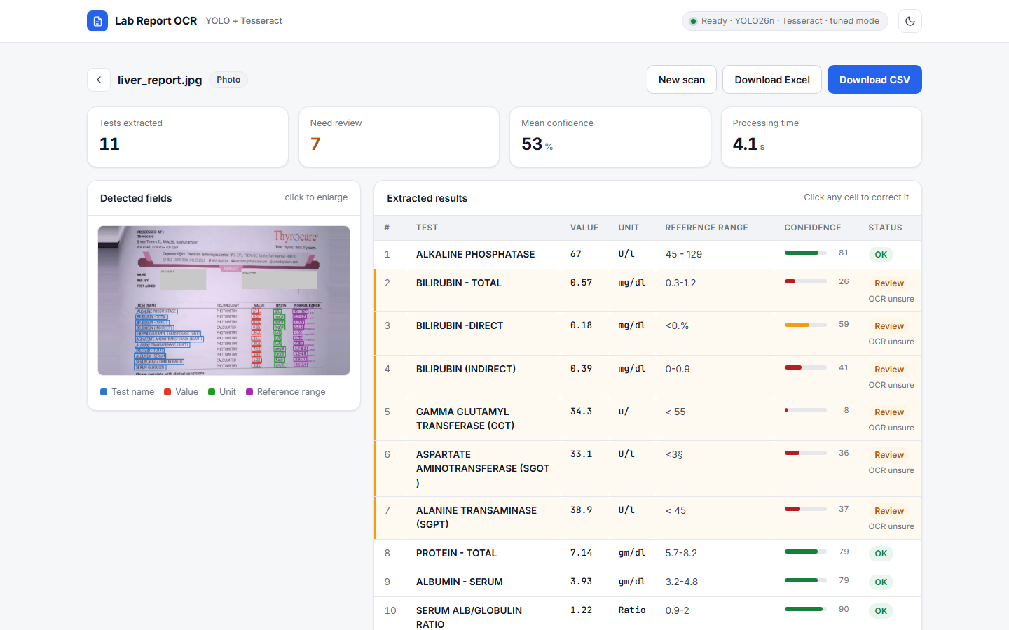
Upload a report, check the table, download
FUNCTIONALITY · WEB APP
Drop in any report
Photo or PDF, or one-click samples
See what was found
Fields boxed on the page; summary tiles
Fix what is flagged
Editable cells, reasons and confidence
Download or integrate
CSV / Excel with edits; JSON API
Lab Report OCR · YOLO + Tesseract
12
Notes:
This is the web app after reading the sample liver report. A user drops in a photo or PDF, or clicks one of the built-in samples. The page shows four summary tiles: tests extracted, rows needing review, mean confidence and processing time. Beside the annotated photo, the extracted table has one row per test; flagged rows are tinted amber with the reason, and each row shows a confidence bar. Every cell is editable, and the CSV and Excel downloads include the corrections. The same server exposes a JSON API with interactive docs at /docs, works in light and dark mode, and fits a phone screen. It runs with one command: uvicorn app.server:app, or docker run custom-ocr serve.

Slide 13
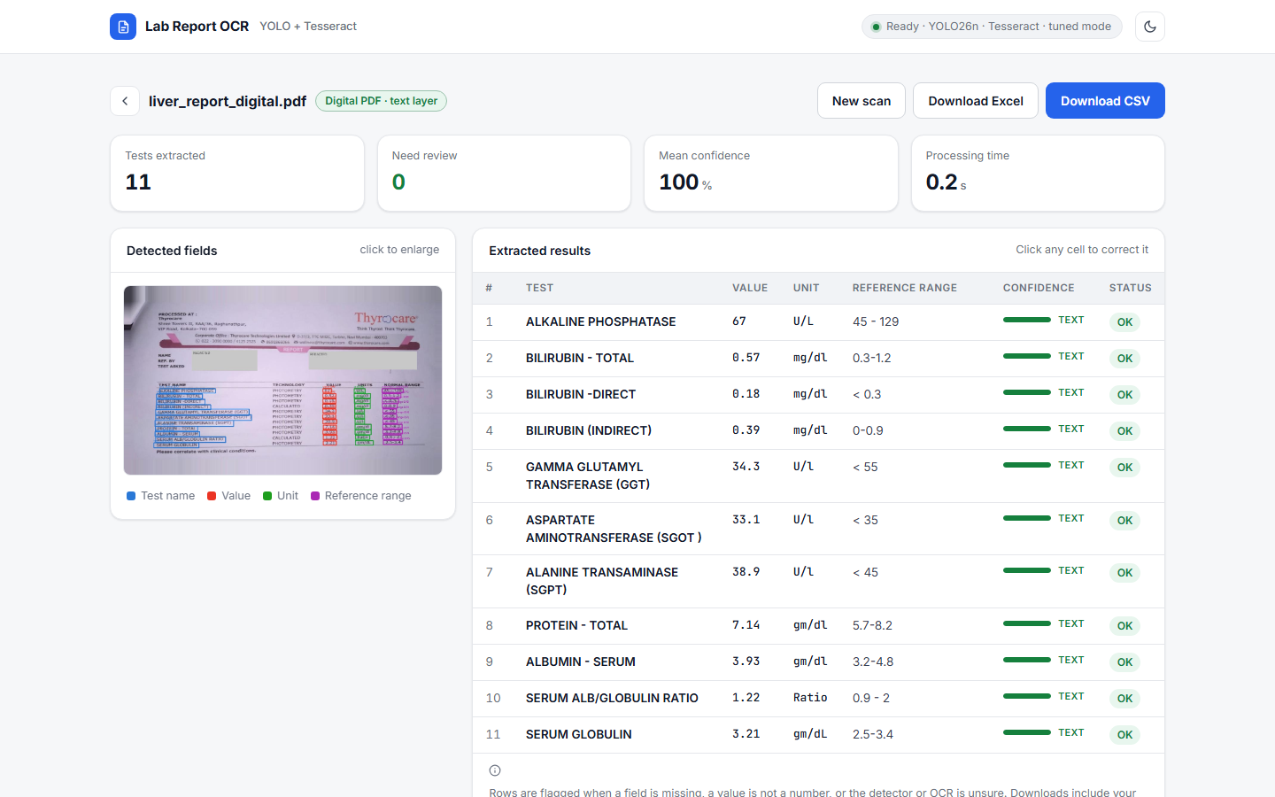
Each kind of PDF is read its own way
FUNCTIONALITY · PDF INPUT
Scanned PDF
Rendered at the scan’s own resolution, then OCR. Multi-page: same results as photos.
Searchable scan
Its hidden OCR layer is ignored; our field-level OCR is more accurate.
Digital PDF
Fields read from the PDF’s text layer: 44 of 44 exact, vs 42 via OCR.
Lab Report OCR · YOLO + Tesseract
13
Notes:
Reports often arrive as PDFs, so the pipeline reads them too, up to 20 pages, with a page column in the output. There are three cases. A scanned PDF is just images, so each page is rendered at the scan’s native resolution, which keeps the text the size the detector learned, and then read with OCR. A searchable scan carries an invisible OCR layer made by the scanner; it is usually worse than our field-level OCR, so it is ignored. A digital PDF has real text: the detector still finds the fields, but each one is read straight from the PDF’s text layer, which is exact. On a digital test page, all 44 fields came out right, against 42 with OCR. The screenshot shows that case in the app. One caveat: the digital sample was built from a test photo plus its true text, because the dataset has no real digital PDFs.

Slide 14



One Docker image, four ways to run
FUNCTIONALITY · DEPLOYMENT AND AWS
Web app + API
SageMaker endpoint
docker run custom-ocr serve, on a laptop or any server
Serverless: answers /ping and /invocations, $0 when idle
SageMaker training job
Batch processing job
Spot GPU reads data from S3, writes model.tar.gz back
Every report in an S3 folder becomes CSV + Excel
Cost: $0 on Colab + Drive; well under $1 on AWS
AWS scripts tested offline, not yet on a live account
Lab Report OCR · YOLO + Tesseract
14
Notes:
Deployment is built around a single Docker image with Tesseract and the trained model inside. Started with serve, it is the web app and API. Because the same server also implements SageMaker’s hosting contract, the image deploys unchanged as a serverless SageMaker endpoint, which costs nothing while idle. Started with train, it runs as a SageMaker training job that reads the dataset from S3 and writes the weights back. As a Processing job, it reads every report in an S3 folder and writes CSV and Excel files back. A boto3 script, sm_jobs.py, drives every step, plus S3 sync, a notebook instance that auto-stops when idle, and a cleanup command; notebook 06 walks through it. The container was tested locally against SageMaker’s serving and training contracts and every AWS request was checked in dry-run mode, but nothing has run against a live account yet. Cost: zero on Colab, and with spot training and a serverless endpoint, under a dollar on AWS.

Slide 15
Where it stops today, and what comes next
SCOPE AHEAD
Limits
Next steps
Knows 3 report designs only
Small test set: 14 photos, 222 fields
Tesseract struggles on 6–8 px print
AWS path not yet run on a live account
Label 5–10 pages per new lab layout
Try PaddleOCR or TrOCR on value crops
Flag values far outside their own range
Deploy on AWS with a real account
github.com/Subharshi1997/NextHikes-Project-9-MedicalReportReader
15
Notes:
To close on scope. The detector has learned three report designs; supporting a new lab means labelling about five to ten of its pages, which the homography tool makes quick. The test set is small, so differences of a couple of points are noise. The weakest link is Tesseract on very small print, which is why the vitamin page scores lowest; the next lever is a stronger OCR model on value and unit crops. A cheap clinical safeguard would flag any value far outside its own reference range. And the AWS deployment is ready to run as soon as an account and an IAM role are available. Everything shown today, code, notebooks, results and the report, is in the GitHub repository on screen.

